Slide 1

Lecture 7: TAU Applications
Allen D. Malony
Department of Computer and Information Science

Slide 2
Short Course Outline
Lecture 1: Introduction and Fundamentals
Lecture 2: Methodology
Lecture 3: Tools Technology
Lecture 4: Tools Landscape – Part 1
Lecture 5: Tools Landscape – Part 2
Lecture 6: TAU Performance System
Lecture 7: TAU Applications
Lecture 8: Advances in TAU
Lecture 9: Future Directions
Tuesday
Wednesday
Thursday

Slide 3
Outline
Performance problem solving objectives
Applications
S3D: turbulent combustion
NWChem: computational chemistry
MPAS: atmospheric simulation
XGC: gyrokinetic microturbulence
IRMHD: magneto hydrodynamics
CESM: earth simulation

Slide 4
Performance Problem Solving Goals
Answer questions at multiple levels of interest
Performance experiments to identify problems
characterization from performance data measurements
High-level performance across dimensions
machine, applications, code revisions, data sets
examine broad performance trends
Discover general correlations
Performance features between experiments
Identify primary performance behavior across parameters
Conduct meta analysis to uncover principal factors
Feedback performance problem identification and knowledge about features/factors to optimize

Slide 5
S3D Scalability Study
S3D flow solver for turbulent combustion simulation
Performance scaling study (C2H4 benchmark)
Cray XT3+XT4 hybrid, XT4 (ORNL, Jaguar)
IBM BG/P (ANL, Intrepid)
Weak scaling (1 to 12000 cores)
Evaluate scaling of code regions and MPI
Demonstration of scalable performance measurement, analysis, and visualization
Understanding scalability
Requires environment for performance investigation
Performance factors relative to main events

Slide 6
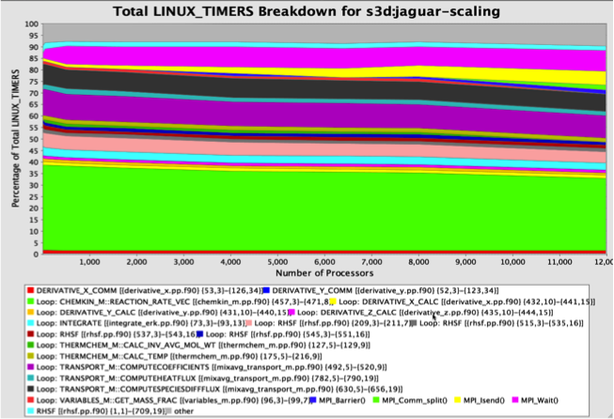
S3D Total Runtime Breakdown by Events (Jaguar)
MPI

Slide 7

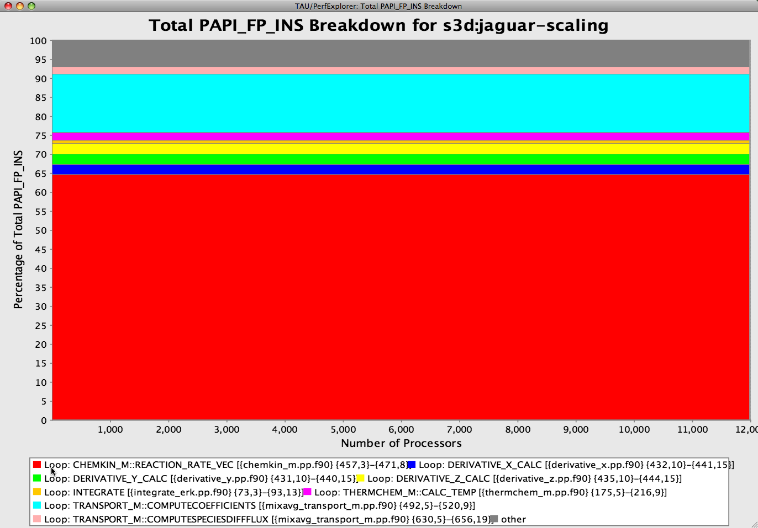
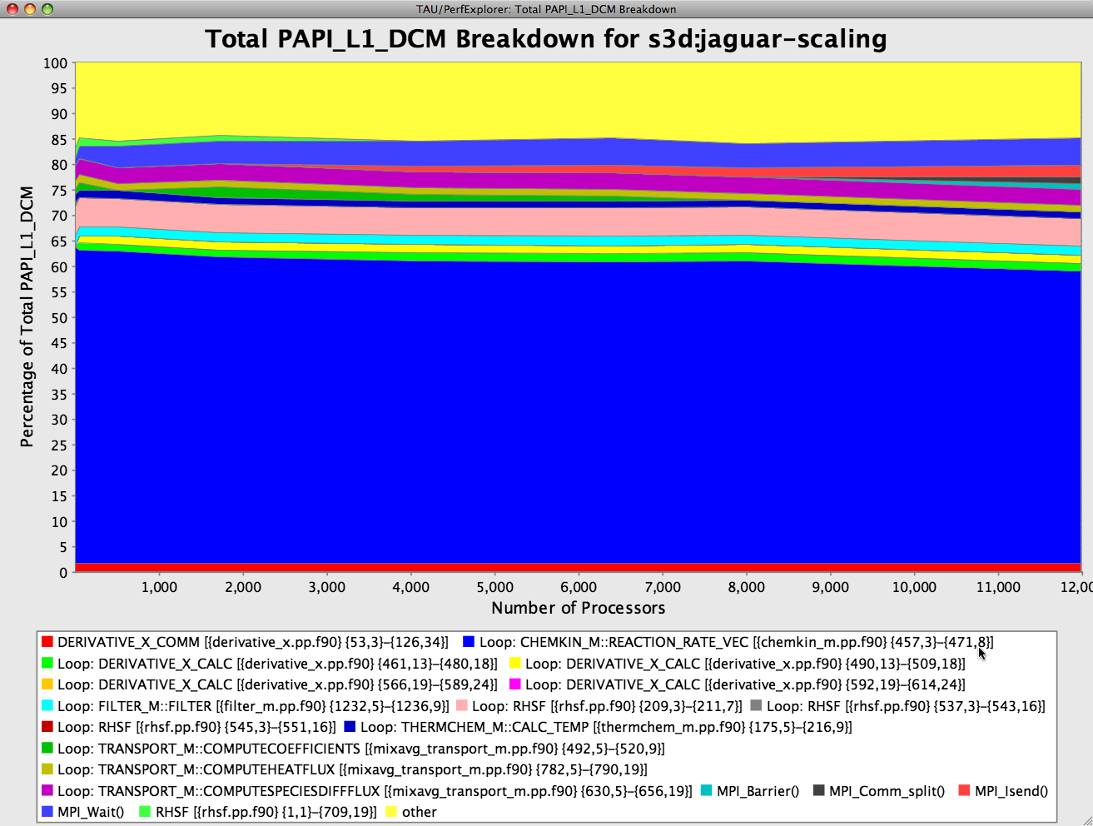
S3D FP Instructions/L1 Data Cache Miss (Jaguar)

Slide 8
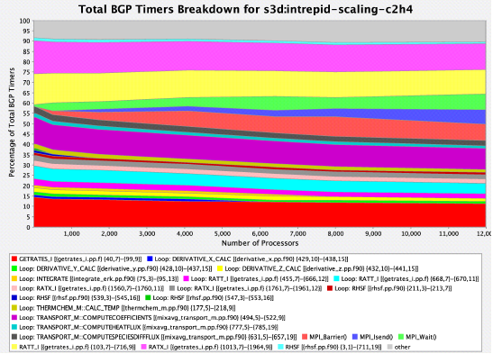
S3D Total Runtime Breakdown by Events (Intrepid)
MPI

Slide 9
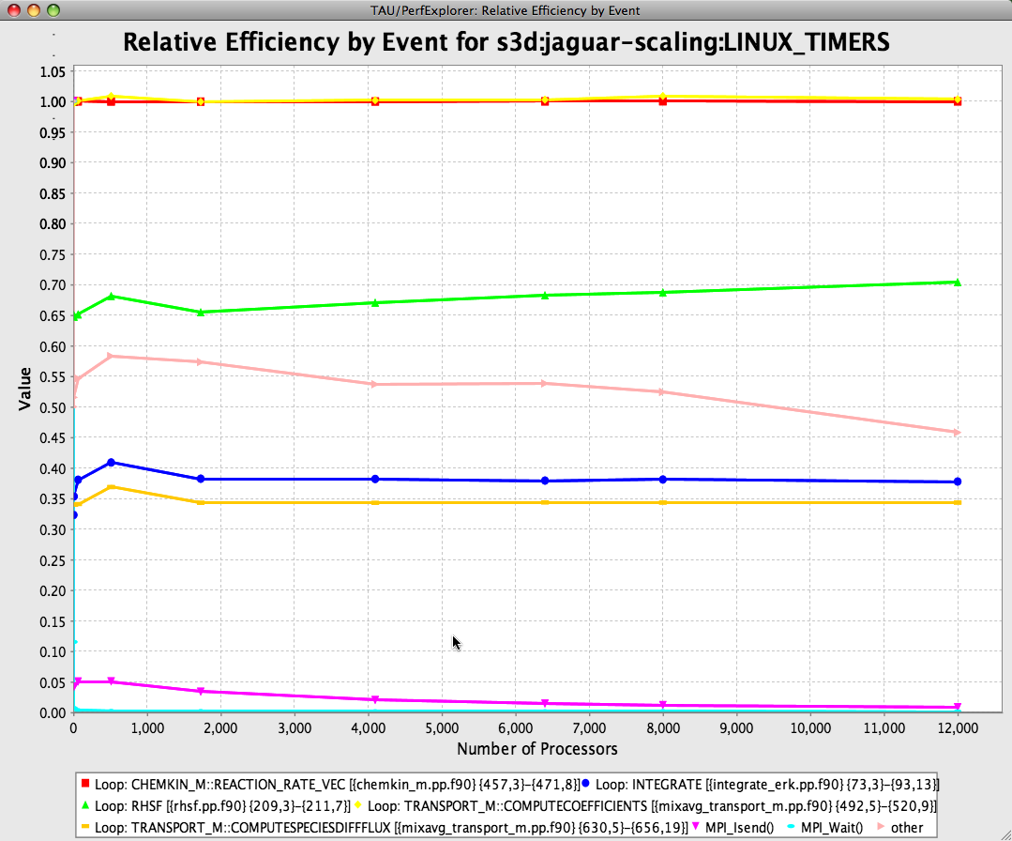
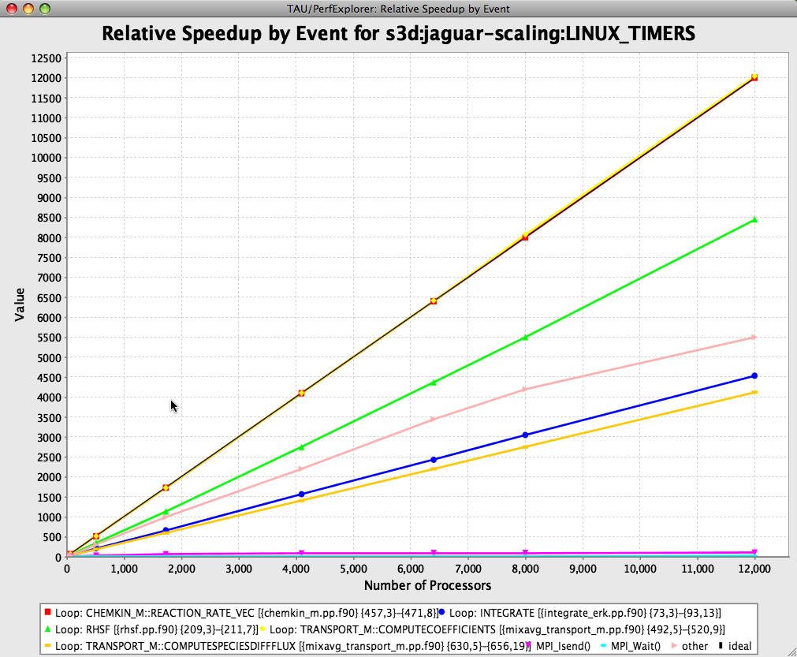
S3D Relative Efficiency/Speedup by Event (Jaguar)

Slide 10
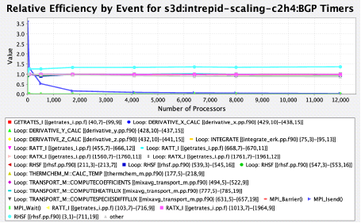
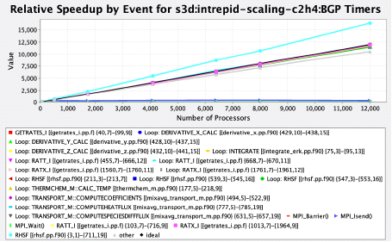
S3D Relative Efficiency by Event (Intrepid)

Slide 11
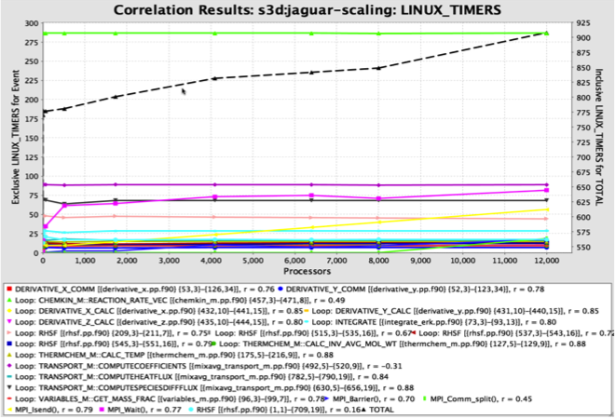
S3D Event Correlation to Total Time (Jaguar)
r = 1 implies
direct correlation

Slide 12
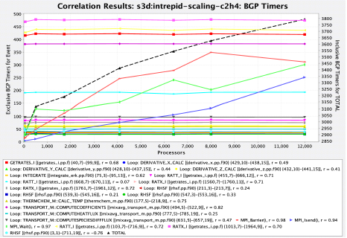
S3D Event Correlation to Total Time (Intrepid)

Slide 13
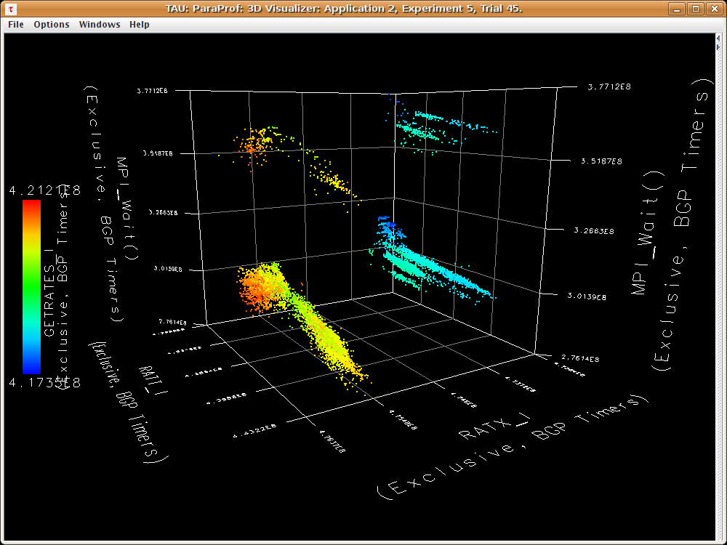
S3D 3D Correlation Cube (Intrepid, MPI_Wait)
12K cores
GETRATES_I vs. RATI_I vs. RATX_I vs. MPI_Wait

Slide 14
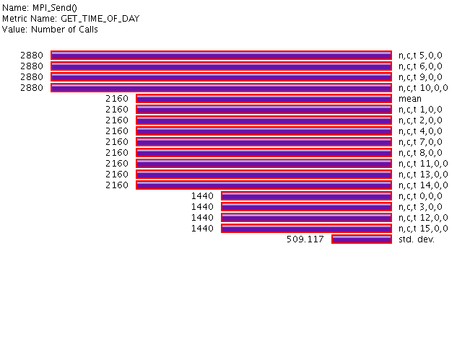
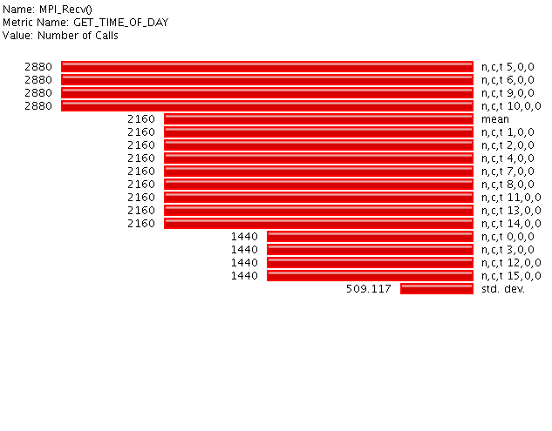
S3D Computational Structure
Domain decomposition with wavefront evaluation and recursion dependences in all 3 grid directions
Communication affected by cell location
12
13
14
15
4x4 example:
8
9
10
11
2 neighbors
4
5
6
7
3 neighbors
0
1
2
3
4 neighbors
Center cells
Corner cells
Notes:
logical topology
Top-down view of domain, decomposed along x,y into pencils (z-axis) all z data allocated to one processor
Each processor processes through the z dimension to launch neighbors quickly
The numbers in the cells represent the MPI ranks in the logical topology

Slide 15
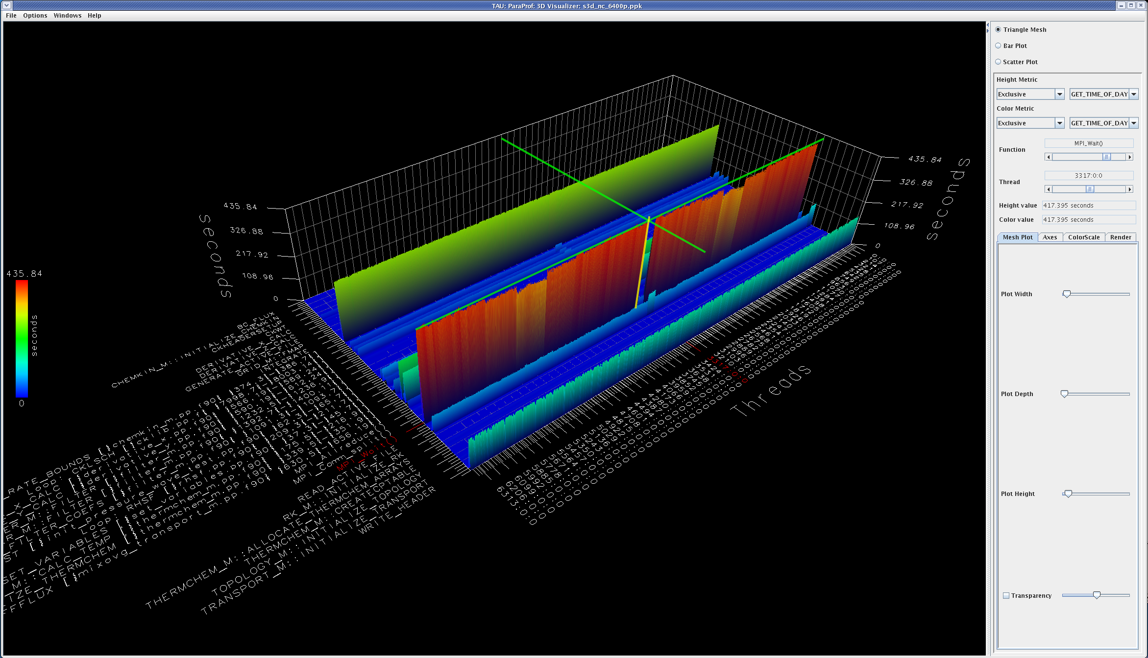
S3D on a Hybrid System (Cray XT3 + XT4)
6400 core execution on transitional Jaguar configuration
MPI_Wait
ORNL Jaguar * Cray XT3/XT4 * 6400 cores

Slide 16
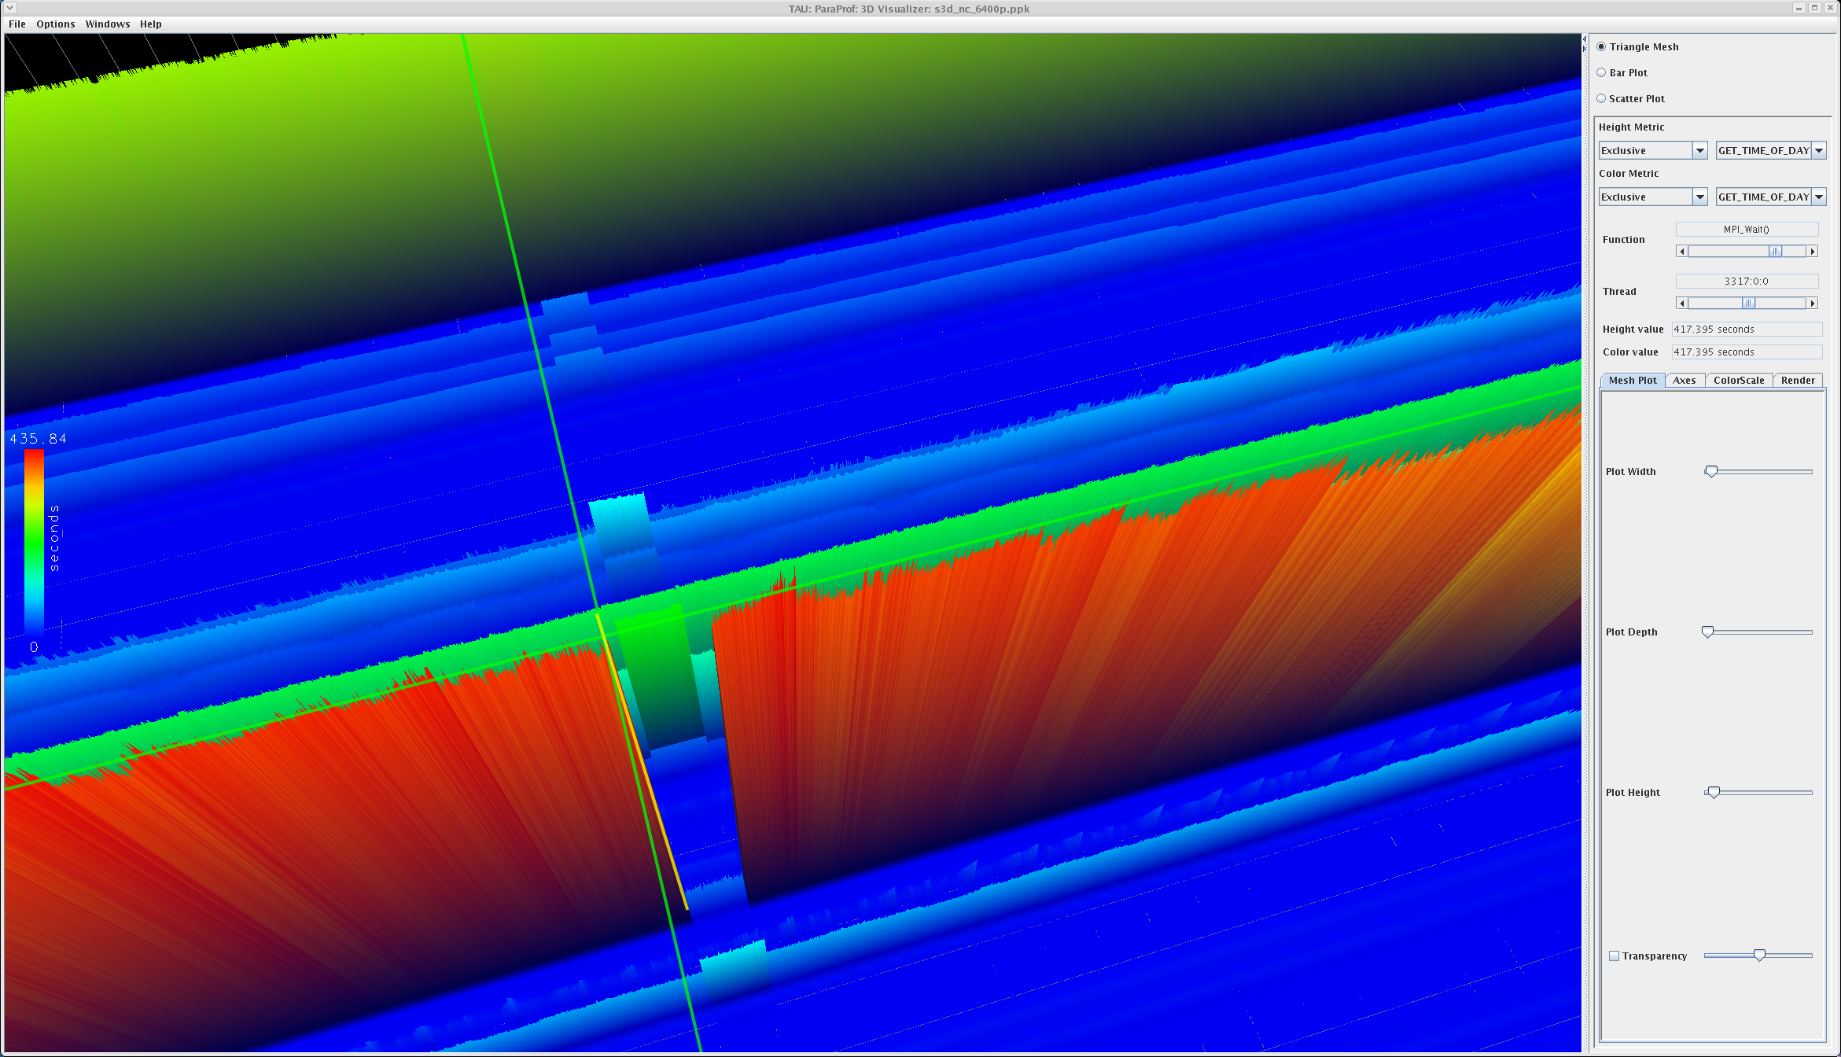
Zoom View of Parallel Profile (S3D, XT3+XT4)
Gap happens to be only XT3 nodes
MPI_Wait takes less time, other routines take more time

Slide 17
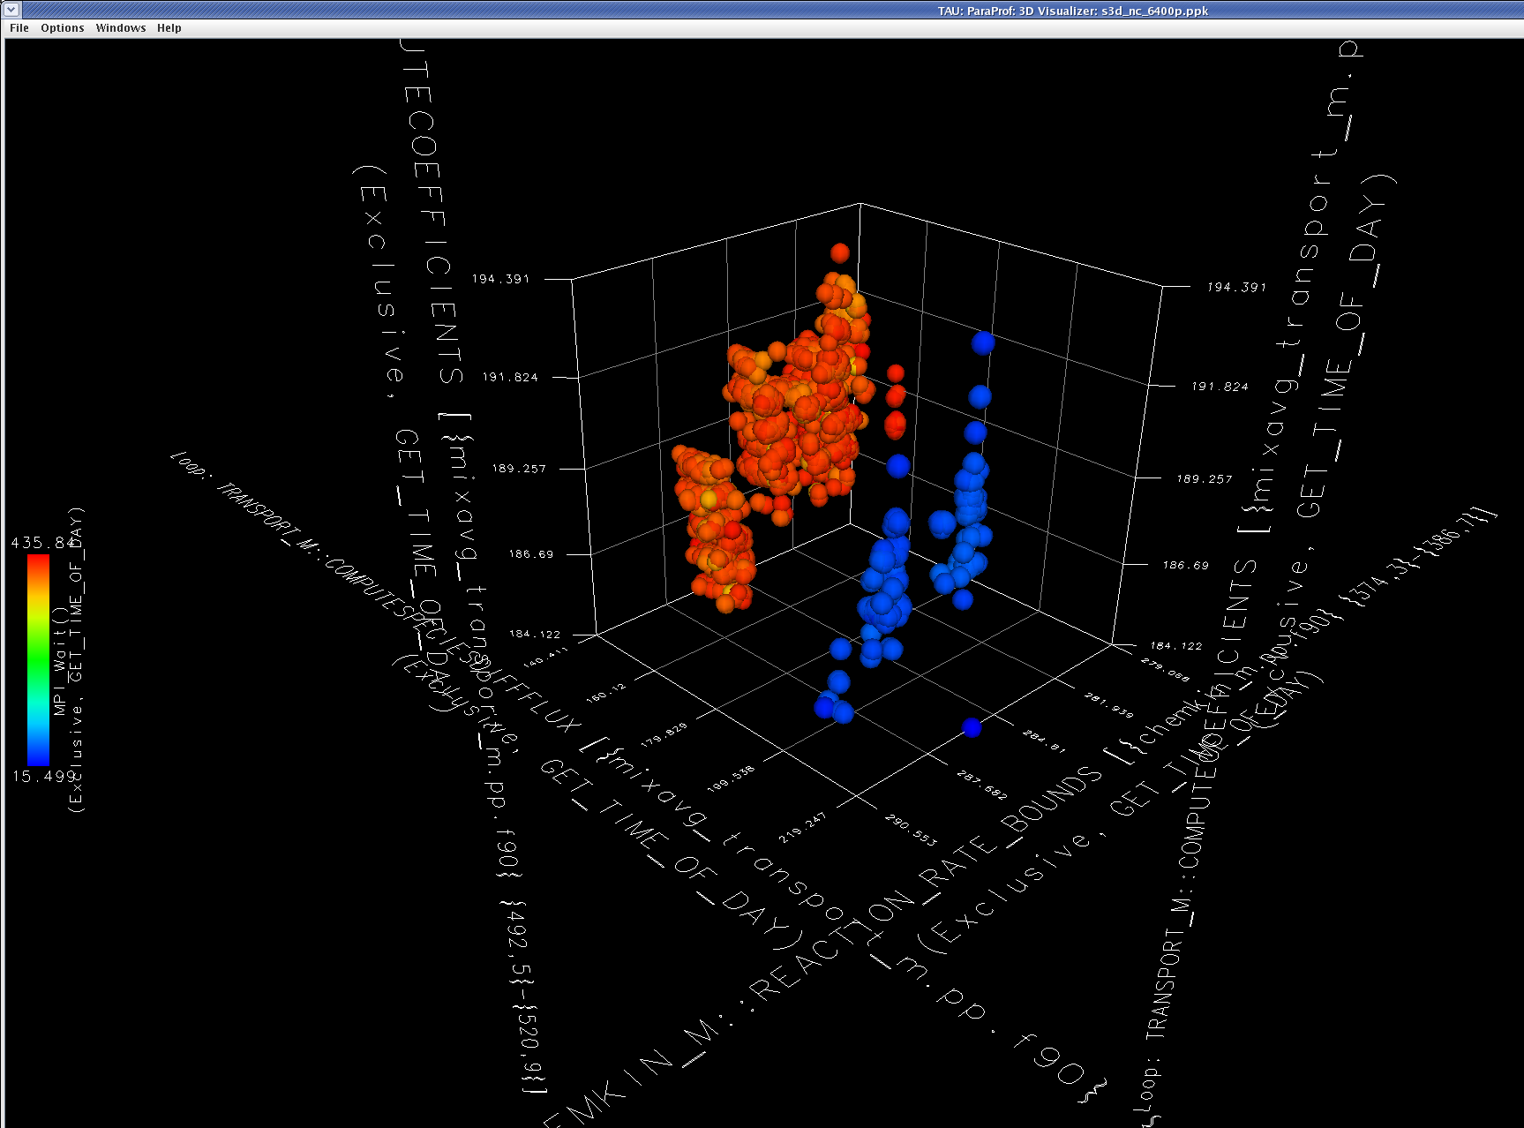
Scatterplot (S3D, XT3+XT4)
Scatterplot of top three events colored by total time
Two clusters
Memory speed accounts for performance difference!!!
Process metadata can identify the different nodes
XT3 cores
XT4 cores

Slide 18
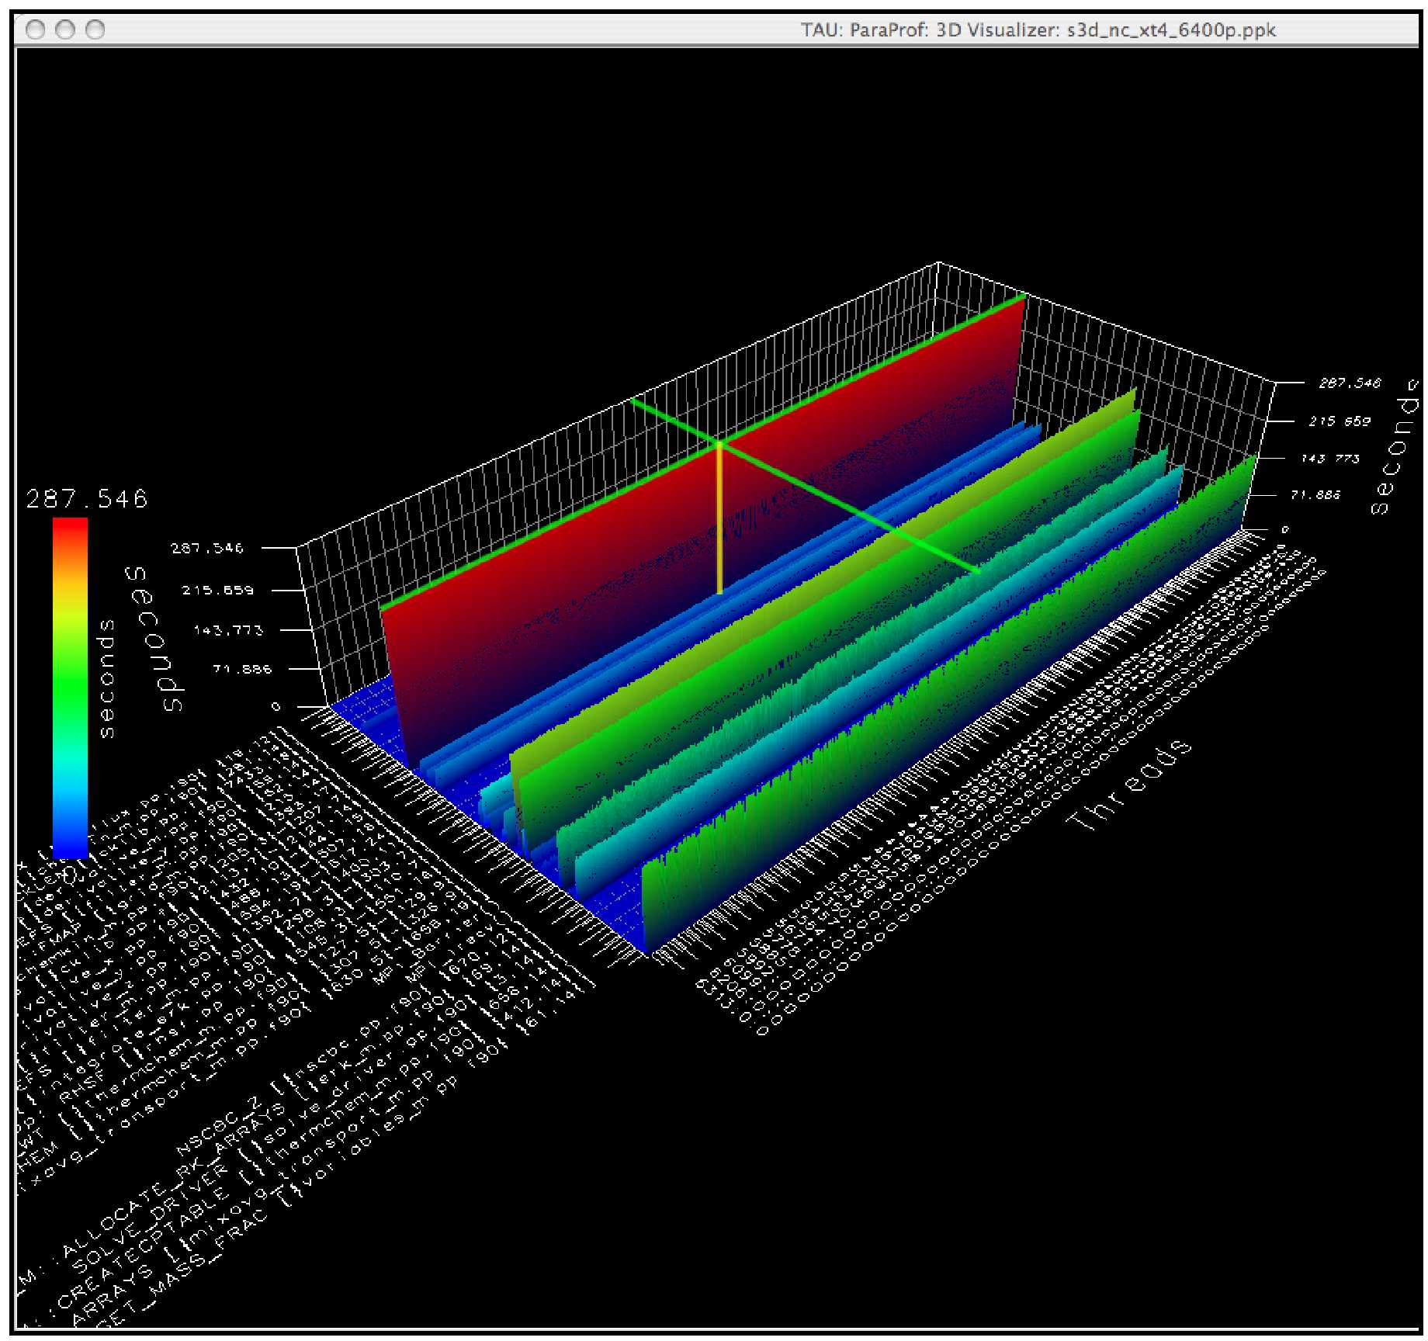
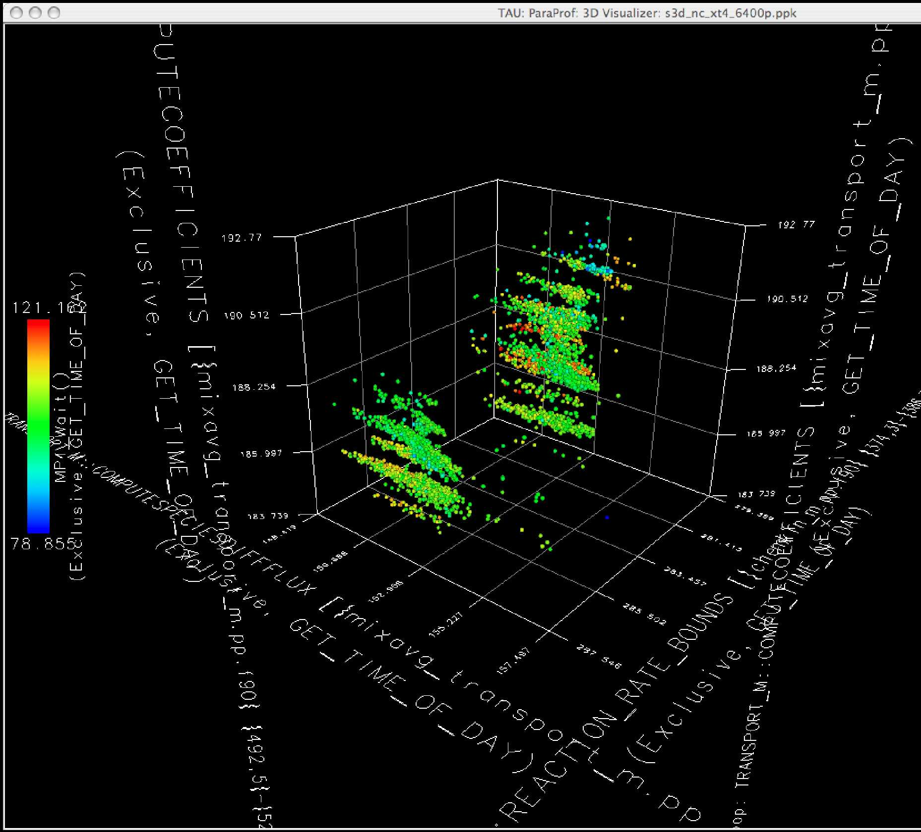
S3D Run on XT4 Only
Better balance across nodes
More uniform performance

Slide 19
Capturing Analysis and Inference Knowledge
Create PerfExplorer workflow for S3D case study?
Load Data
Extract
Non-callpath data
Extract top
5 events
Load metadata
Correlate events
With metadata
Process
inference rules

Slide 20
PerfExplorer Workflow Applied to S3D
--------------- JPython test script start ------------
doing single trial analysis for sweep3d on jaguar
Loading Rules...
Reading rules: rules/GeneralRules.drl... done.
Reading rules: rules/ApplicationRules.drl... done.
Reading rules: rules/MachineRules.drl... done.
loading the data...
Getting top 10 events (sorted by exclusive time)...
Firing rules...
MPI_Recv(): "CALLS" metric is correlated with the metadata field "total neighbors".
The correlation is 1.0 (direct).
MPI_Send(): "CALLS"metric is correlated with the metadata field "total Neighbors".
The correlation is 1.0 (direct).
MPI_Send(): "P_WALL_CLOCK_TIME:EXCLUSIVE" metric is correlated with the metadata field "total neighbors".
The correlation is 0.8596 (moderate).
SOURCE [{source.f} {2,18}]: "PAPI_FP_INS:EXCLUSIVE" metric is inversely correlated with the metadata field "Memory Speed (MB/s)".
The correlation is -0.9792 (very high).
SOURCE [{source.f} {2,18}]: "PAPI_FP_INS:EXCLUSIVE" metric is inversely correlated with the metadata field "Seastar Speed (MB/s)".
The correlation is -0.9785258663321764 (very high).
SOURCE [{source.f} {2,18}]: "PAPI_L1_TCA:EXCLUSIVE" metric is inversely correlated with the metadata field "Memory Speed (MB/s)”.
The correlation is -0.9818810020169854 (very high).
SOURCE [{source.f} {2,18}]: "PAPI_L1_TCA:EXCLUSIVE" metric is inversely correlated with the metadata field "Seastar Speed (MB/s)”.
The correlation is -0.9810373923601381 (very high).
SOURCE [{source.f} {2,18}]: "PAPI_L2_TCM:EXCLUSIVE" metric is inversely correlated with the metadata field "Memory Speed (MB/s)”.
The correlation is 0.9985297567878844 (very high).
SOURCE [{source.f} {2,18}]: "PAPI_L2_TCM:EXCLUSIVE" metric is inversely correlated with the metadata field "Seastar Speed (MB/s)”.
The correlation is 0.996415213842904 (very high).
SOURCE [{source.f} {2,18}]: "P_WALL_CLOCK_TIME:EXCLUSIVE" metric is inversely correlated with the metadata field "Memory Speed (MB/s)”.
The correlation is -0.9980107779462387 (very high).
SOURCE [{source.f} {2,18}]: "P_WALL_CLOCK_TIME:EXCLUSIVE" metric is inversely correlated with the metadata field "Seastar Speed (MB/s)”.
The correlation is -0.9959749668655212 (very high).
...done with rules.
---------------- JPython test script end -------------
Correlated communication
behavior with metadata
Identified
hardware
differences
Cray-specific inference

Slide 21
NWChem Case Study
NWChem is a leading chemistry modeling code
NWChem relies on Global Arrays (GA)
Provides a global view of a physically distributed array
One-sided access to arbitrary patches of data
Developed as a library (fully interoperable with MPI)
Aggregate Remote Memory Copy Interface (ARMCI)
GA communication substrate for one-sided communication
Portable high-performance one-sided communication library
Rich set of remote memory access primitives
Would like to better understand the performance of representative workloads for NWChem on different platforms
Help to create use cases for one-side programming models

Slide 22
NWChem One-sided Communication and Scaling
Understand interplay between data-server and compute processes as a function of scaling
Data-server uses a separate thread
Large numerical computation per node at small scale can obscure the cost of maintaining passive-target progress
Larger scale decreases numerical work per node and increases the fragmentation of data, increasing messages
Vary #nodes, cores-per-node, and memory buffer pinning
Understand trade-off of core allocation
All to computation versus some to communication
J. Hammond, S. Krishnamoorthy, S. Shende, N. Romero, A. Malony, “Performance Characterization of Global Address Space Applications: a Case Study with NWChem,” Concurrency and Computation: Practice and Experience, Vol 24, No. 2, pp. 135-154, 2012.

Slide 23
NWChem Instrumentation
Source-base instrumentation of NWChem application
Developed an ARMCI interposition library (PARMCI)
Defines weak symbols and name-shifted PARMCI interface
Similar to PMPI for MPI
Developed a TAU PARMCI library
Intervals events around interface routines
Atomic events capture communication size and destination
Wrapped external libraries
BLAS (DGEMM)
Need portable instrumentation for cross-platform runs
Systems
Fusion: Linux cluster, Pacific Northwest National Lab
Intrepid: IBM BG/P, Argonne National Lab

Slide 24
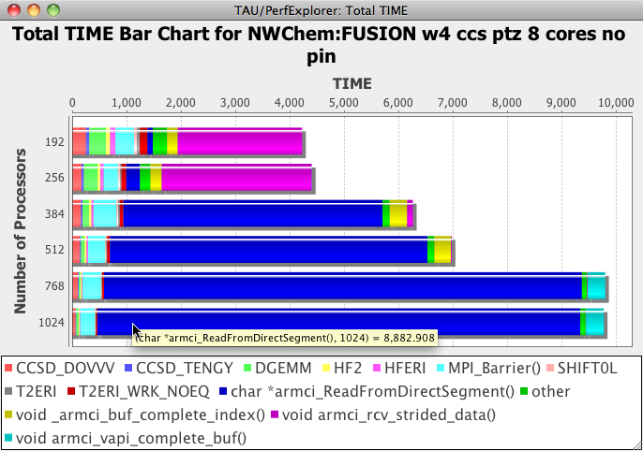
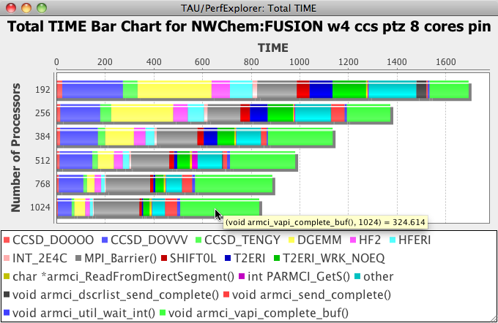
FUSION Tests Comparing No Pinning vs. Pinning
Scaling on 24, 32, 48, 64, 96 and 128 nodes
Test on 8 cores (no separate data server thread)
With no pinning ARMCI communication overhead increases dramatically and no scaling is observed
Pinning communication buffers shows dramatic effects
Relative communication overhead increases, not dramatically
DGEMM
DGEMM

Slide 25
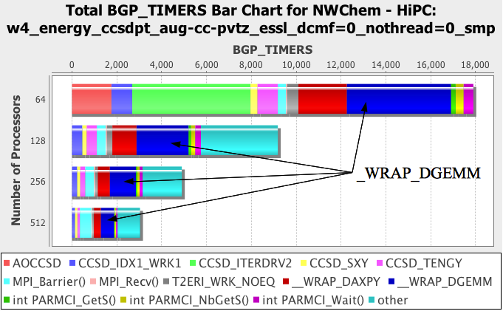
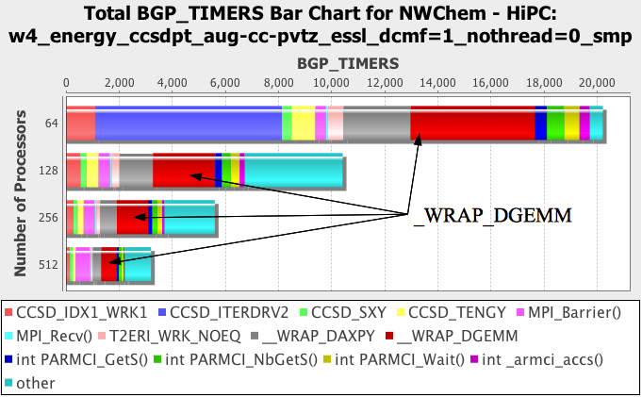
Intrepid Tests Comparing No Pinning vs. Pinning
Scaling on 64, 128, 256 and 512 nodes
Tests with interrupt or communication helper thread (CHT)
CHT requires a core to be allocated
ARMCI calls are barely noticeable
DAXPY calculation shows up more
CHT performs better in both SMP and DUAL modes

Slide 26
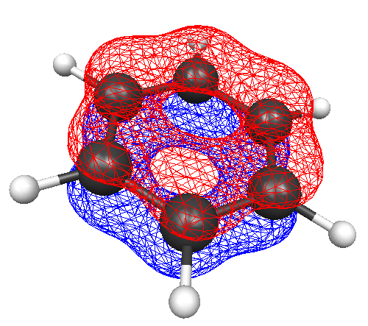
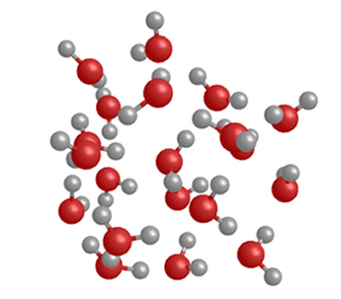
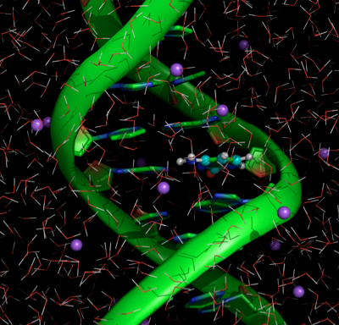
Electronic Structure in Computational Chemistry
Parallel performance is determined by:
How the application is design and developed
The nature and characteristics of the problem
Computational chemistry applications can exhibit:
Highly symmetric diverse load (e.g., Benzene)
Asymmetric unpredictable load (e.g., water clusters)
QM/MM sheer large size (e.g., macro-molecules)
Load balance is crucially important for performance
Benzene
Water Clusters
Macro-Molecules
Notes:
Load balancing in computational chemistry (in particular, when doing coupled cluster calculations)
3 main classes of problems that each convey different load balancing properties
Benzene is an example of a single molecule with a relatively complicated orbital structure, which results in a diverse load of task sizes (which is pretty good for load balancing)
Water clusters have unpredictable loads which strongly depend on the geometry of the system which makes load balancing much more challenging
QM/MM side (Quantum Mechanics / Molecular Mechanics) is the goal (so far relatively unaccomplished) and would require advanced (new) techniques in load balancing, intelligent course graining, and tremendous amounts of computation

Slide 27
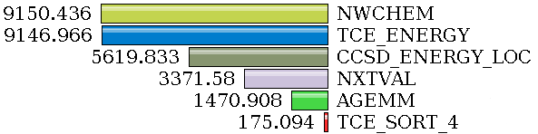
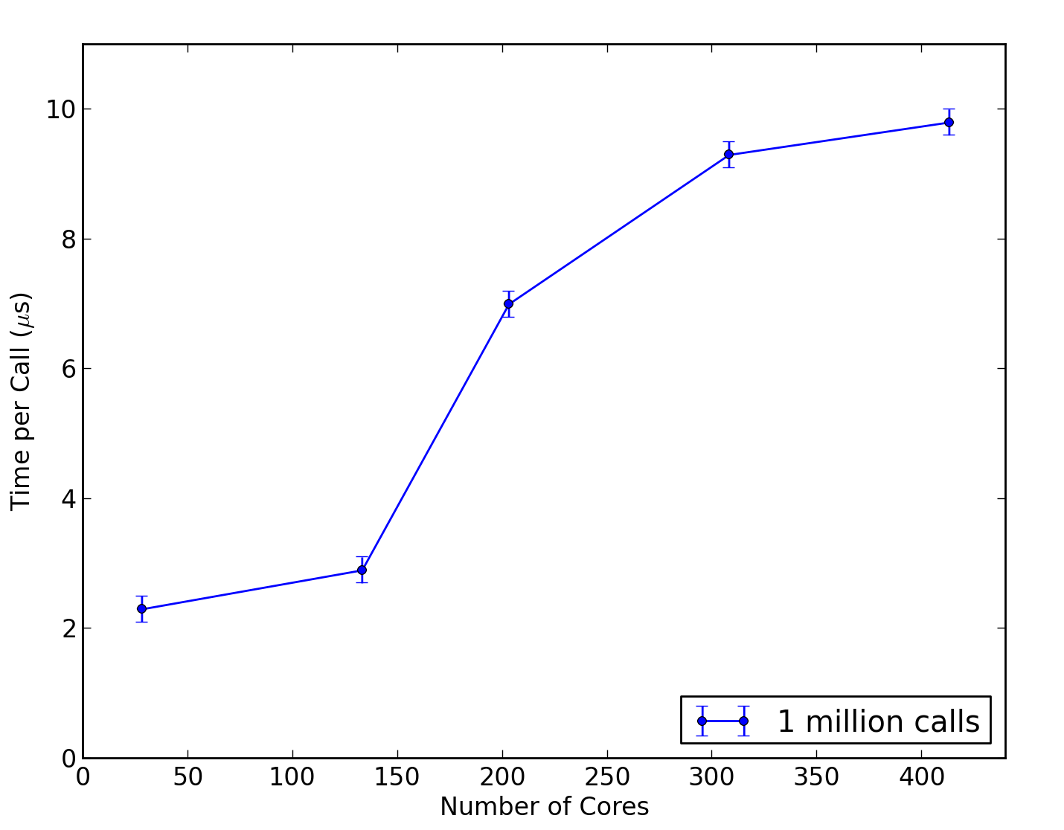
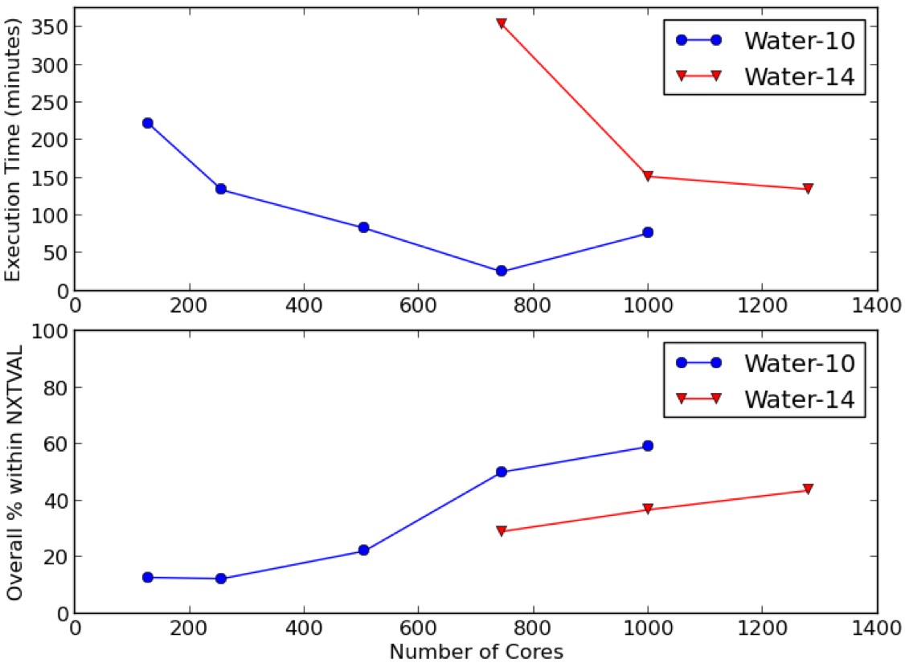
NWChem Performance Analysis – NXTVAL
Focus on NXTVAL
Atomic counter keeping track of which global tasks sent
Strong scaling experiment
14 water molecules
aug-cc-PVDZ dataset
124 nodes on ANL Fusion
8 cores per node
NXTVAL significant %
Increasing per call time
When arrival rate exceeds processing rate, buffering and flow control must be used
NXTVAL
flooding micro-benchmark
NXTVAL
NXTVAL
Notes:
Major problem function in NWChem / Global Arrays – NXTVAL
NXTVAL is an atomic counter that keeps track of which global tasks have been sent out
Time PER CALL to NXTVAL changes as the number of cores is increased

Slide 28
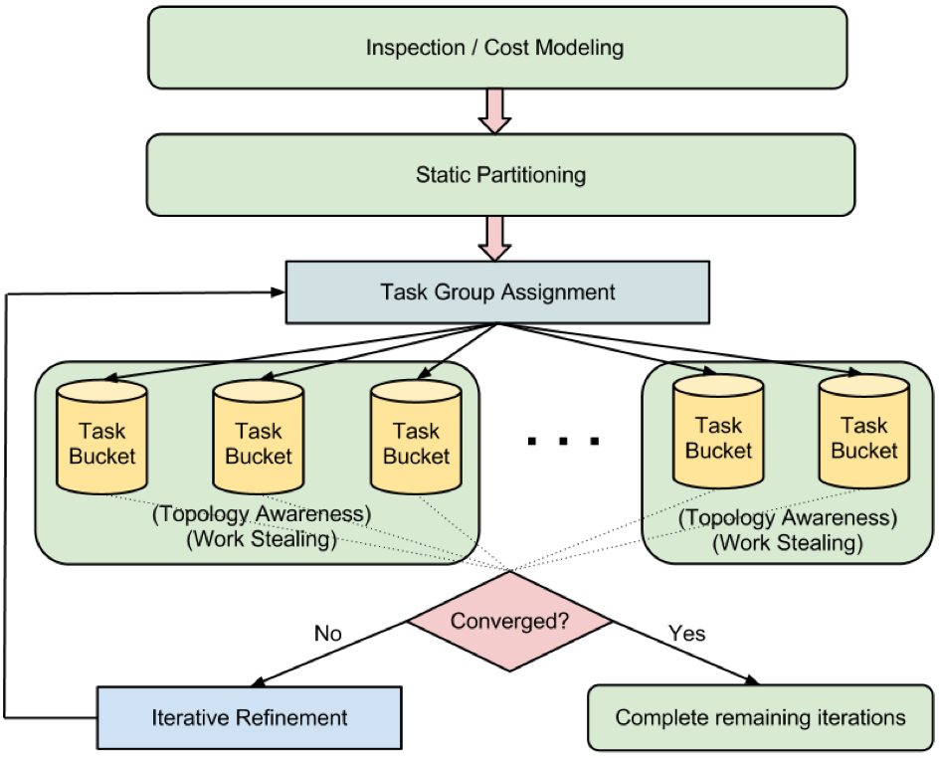
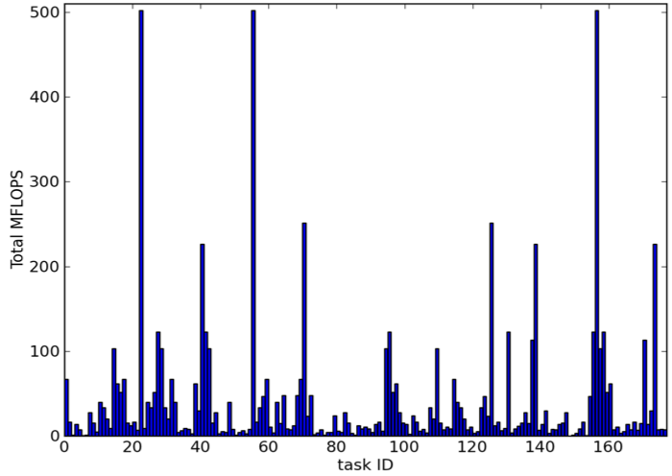
Evaluation of Inspector-Executor Algorithm
How to eliminate the overhead of centralized load balance algorithm based on NXTVAL
Use an inspector-executor approach to assigning tasks
Assess task imbalance
Reassign
Use TAU to evaluate performance improvement with respect to NXTVAL, overhead, task balance
D. Ozog, J. Hammond, J. Dinan, P. Balaji, S. Shende, A. Malony, “Inspector-Executor Load Balancing Algorithms for Block-Sparse Tensor Contractions,” International Conference on Parallel Processing, September 2013.

Slide 29
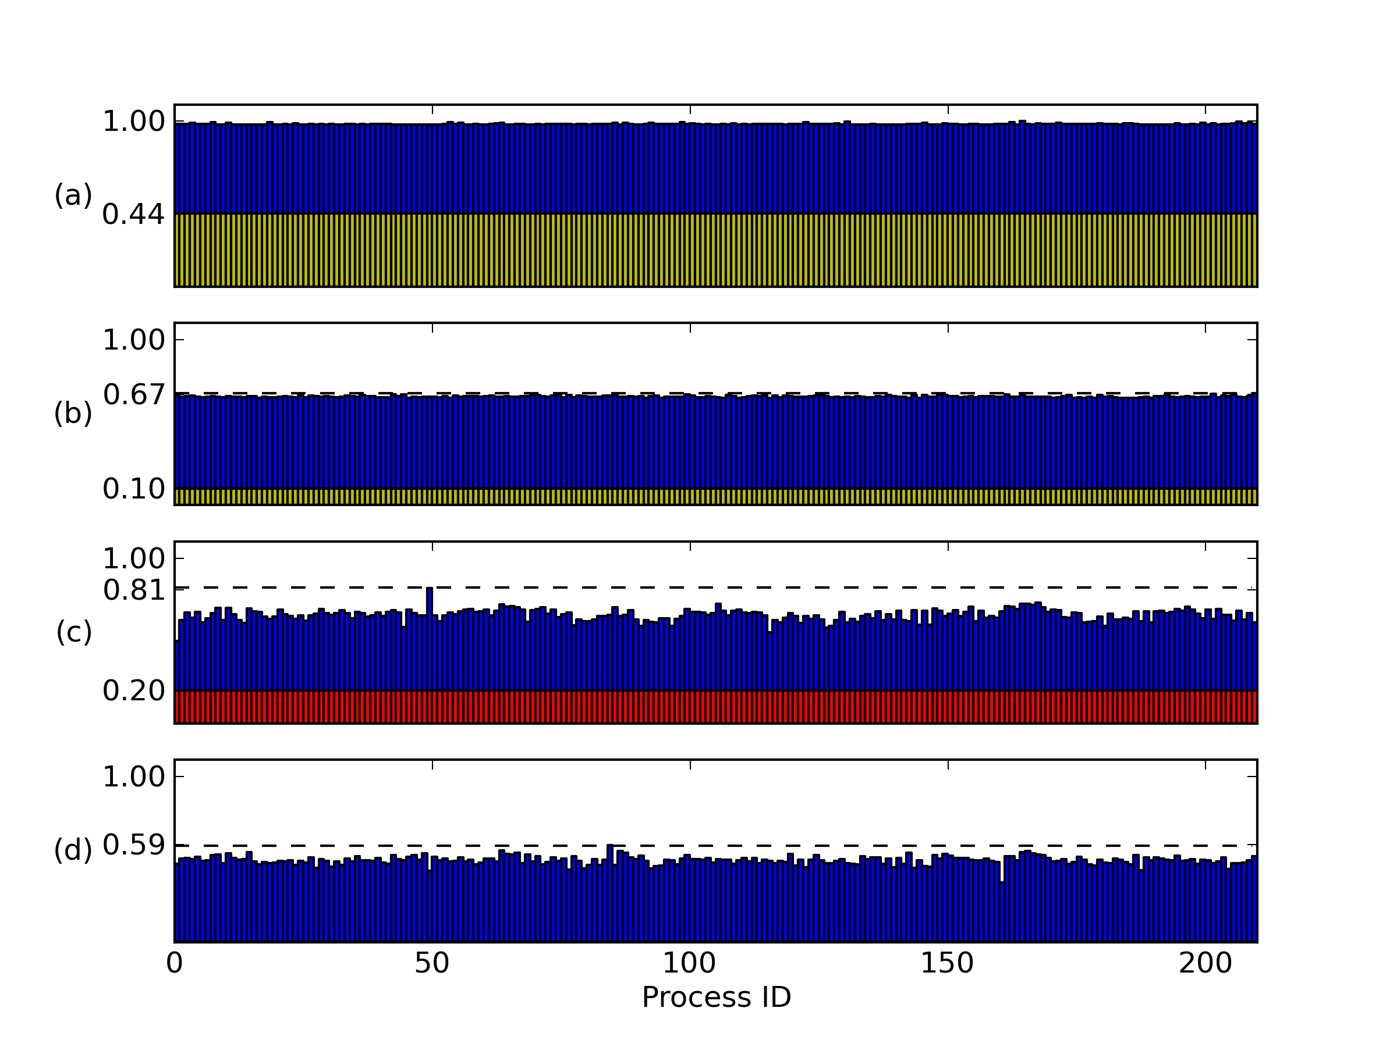
Refinement from NXTVAL to Inspector/Executor
Original NXTVAL measured
Original NXTVAL reduced
Inspector/Executor 1st iteration overhead
Inspector/Executor subsequent iterations
normalize iteration time
Notes:
This plot shows how the load balance changes as we make iterative improvements. (a) shows the original load balance for a particular simulation with the amount of time spent in NXTVAL shown in yellow. (b) shows how we were able to reduce the number of calls to NXTVAL (but that’s another story). Part c is important: it shows the load balance for the first iteration of the simulation with a “best guess” for load distribution (based on performance models of the kernels). Using profile measurements of the 1st iteration, we can adjust the load assignment for subsequent iterations without incurring the overhead of measurement or assignment (since each task cost is fairly static). The moral of the story is that we make about a 40% improvement from the original (comparing (a) to (d)) and about an 8% improvement comparing (b) to (d) for all iterations except the first one.

Slide 30

MPAS (Model for Prediction Across Scales)
MPAS is an unstructured grid approach to climate system modeling
Explore regional-scale climate change
MPAS supports both quasi-uniform and variable resolution meshing of the sphere
Quadrilaterals, triangles, or Voronoi tessellations
MPAS is a software framework for the rapid prototyping of single components of climate system models
Two SciDAC earth systems codes (dynamical cores)
MPAS-O (ocean model)
CAM-SE (atmosphere model)
http://mpas-dev.github.io

Slide 31
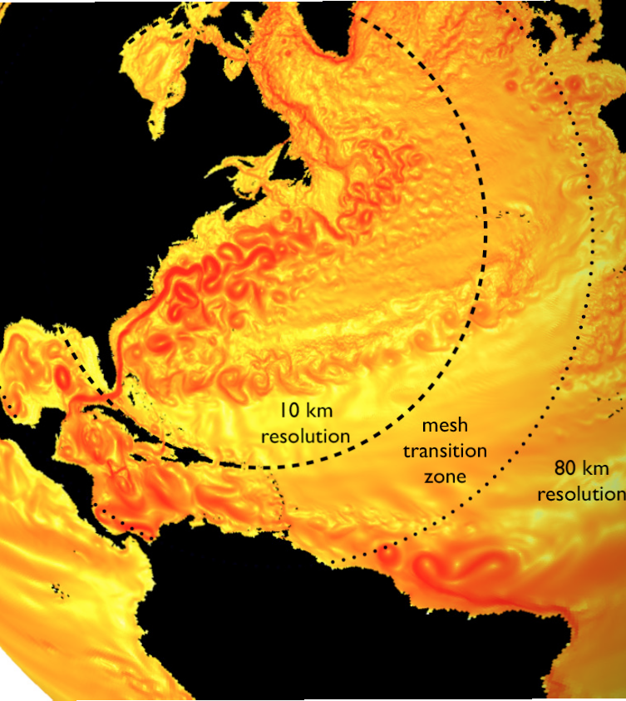
MPAS-Ocean (MPAS-O) Overview
MPAS-O is designed for the simulation of the ocean system from time scales of months to millenia and spatial scales from sub 1 km to global circulations
MPAS-O has demonstrated the ability to accurately reproduce mesoscale ocean activity with a local mesh refinement strategy
In addition to facilitating the study of multiscale phenomena within ocean systems, MPAS-O is intended for the study of anthropogenic climate change as the ocean component of climate system models

Slide 32
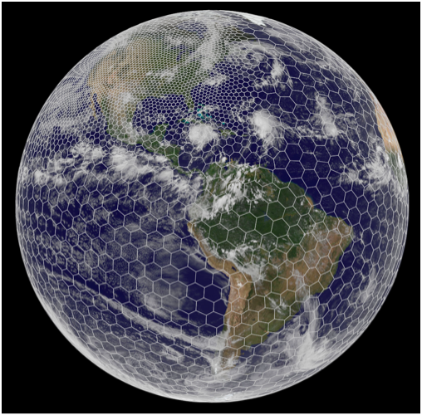
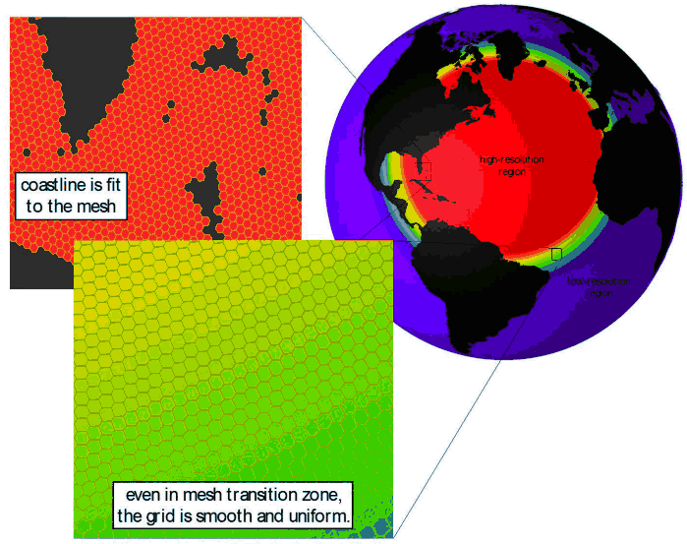
Multiscale and MPAS-O Domain Decomposition
Use multiscale methods for accurate, efficient, and scale-aware models of the earth system
MPAS-O uses a variable resolution irregular mesh of hexagonal grid cells
Cells assigned to MPI processes, grouped as “blocks”
Each cell has 1-40 vertical layers, depending on ocean depth
MPAS-O has demonstrated scaling limits when using MPI alone
Look at increasing concurrency
Developers currently adding OpenMP
Both split explicit and RK4 solvers

Slide 33
MPAS-Ocean Performance Study
Integrate TAU into the MPAS build system
Evaluate the original MPI-only approach
Study the the new MPI+OpenMP approach
Performance results
MPI block + OpenMP element decomposition
reduces total instructions in computational regions
~10% faster than MPI alone
Guided OpenMP thread schedule balances work across threads
~6% faster than default
Weighted block decomposition using vertical elements (depth) could balancing work across processes (~5% faster in some tests)
Overlapping communication and computation could reduce synchronization delays when exchanging halo regions (underway)
Evaluation is ongoing and includes porting to MIC platform

Slide 34
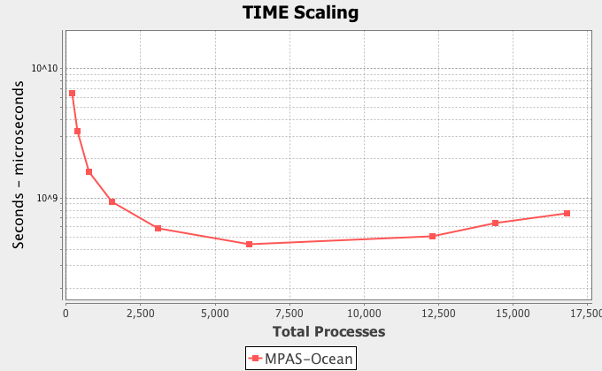
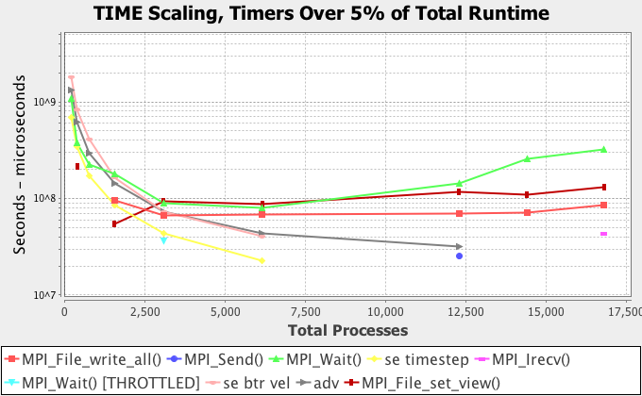
MPI Scaling Study (Hopper)
Strong scaling
192 to 16800
Poor scaling over 6144 processes
Communication begins to dominate
Problem size might be too small
Time profile by events
Only MPI events > 5% after 12K processes
Notes:
As mentioned before, the application was executed with 192 through 16800 processes in a strong scaling study (the total problem size did not change). The application shows poor scaling over 6144 processes, when communication dominates. This problem size might be too small for the larger processor counts?
Broken down by timed regions, the scaling behavior is this (after 12k processes, only MPI routines are more than 5% of the total runtime)

Slide 35
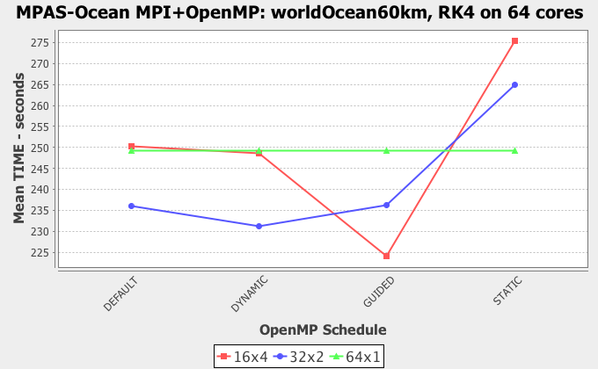
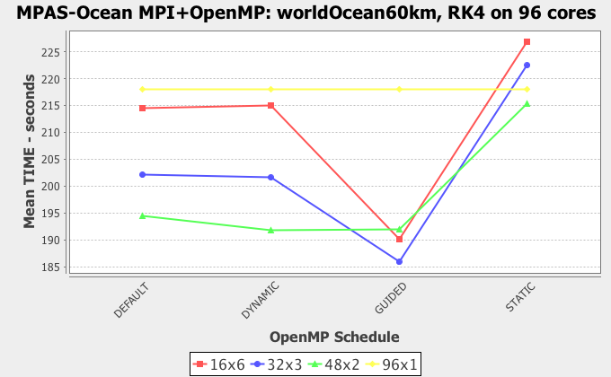
Benefits of RK4 solver and OpenMP Scheduling
Use modified RK4 solver versus original MPI solver
Test cases
64 cores
64 processes (MPI-only)
32 processes x 2 threads
16 processes x 4 threads
96 cores
96 processes (MPI-only)
48 processes x 2 threads
32 processes x 3 threads
16 processes x 6 threads
OpenMP scheduling options evaluated
Notes:
This figure shows the performance benefit when using the modified RK4 solver as compared to the original MPI only solver. The 64x1 test case (baseline) represents the MPI only version of the code with 64 processes, and the 16x4 measurements represent the MPI+OpenMP version with 16 processes and 4 threads each, using different scheduling methods. The guided schedule with 4 threads per process outperforms the MPI only version using the same hardware resources.
This figure shows the performance benefit when using the modified RK4 solver as compared to the original MPI only solver. The 96x1 test case (baseline) represents the MPI only version of the code with 96 processes, and the 16x6 measurements represent the MPI+OpenMP version with 16 processes and 6 threads each, using different scheduling methods. The guided schedule with 3 threads per process outperforms the MPI only version using the same hardware resources.

Slide 36
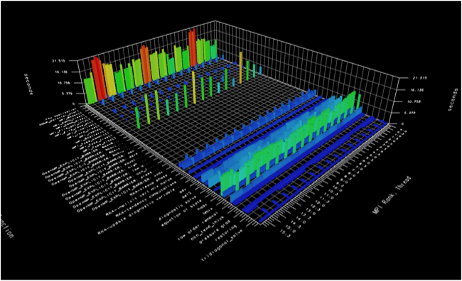
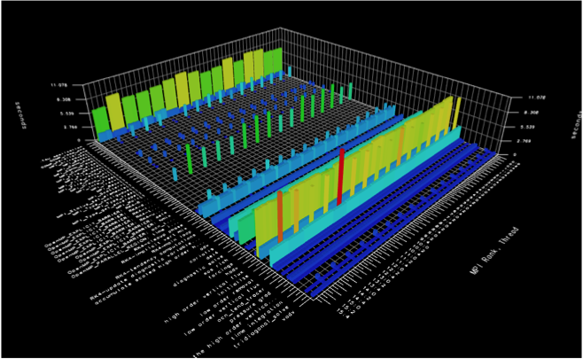
Benefits of Guided Scheduling with MPAS-O RK4
MPI + OpenMP experiment
96 cores (16 processes by 6 threads per process)
Default scheduling generates a load imbalance
Threads arrive at boundary cell exchange at different times
Complete boundary cell exchange at different rates
only the master thread performs the exchange
Guided scheduling provides better balance
asdfas
OpenMP Barrier
OpenMP Barrier
MPI_Wait
MPI_Wait
Default
Guided
Notes:
This figure shows the original load imbalance in the RK4 solver using the default scheduling algorithm with 16 processes and 6 threads per process. The threads of execution arrive at the boundary cell exchange at different rates (Barrier), and the processes complete the boundary cell exchange at different rates (MPI_Wait). Only the master threads perform the exchange.
This figure shows the improved load balance in the RK4 solver using the guided scheduling algorithm with 16 processes and 6 threads per process. The threads of execution arrive at the boundary cell exchange at similar rates (Barrier), and the processes complete the boundary cell exchange at more similar rates (MPI_Wait). Additional work is needed to eliminate the barrier and Wait times by overlapping communication and computation.

Slide 37
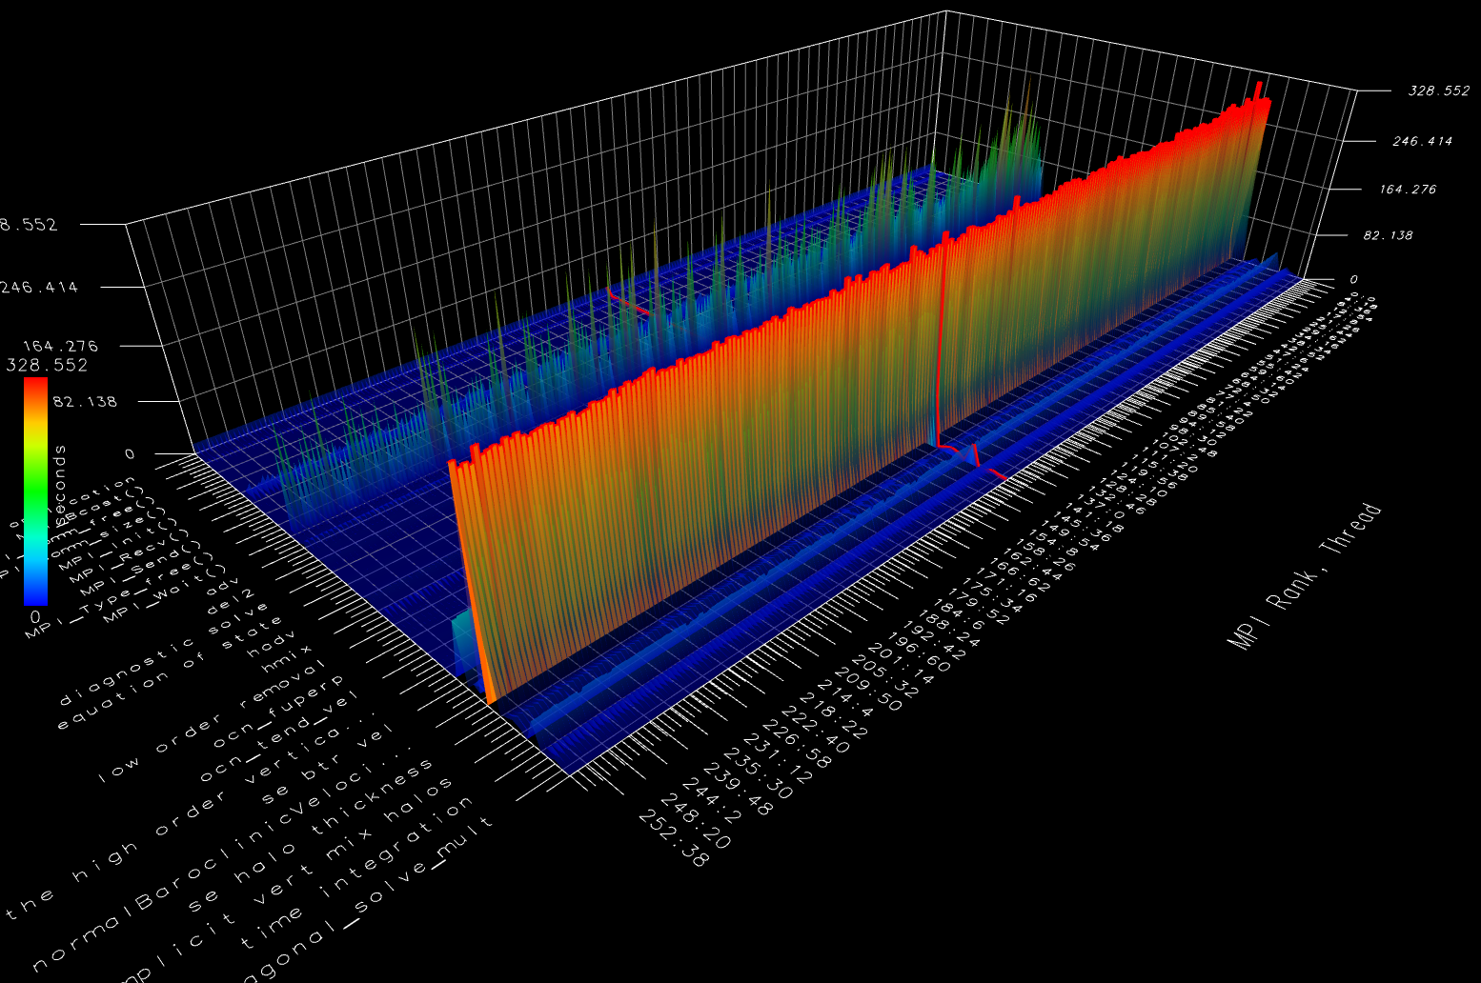
MPAS-O on BG/Q (Vesta) on 16K (256x64)
MPI_Wait() master thread halo exchanges
OpenMP worker threads executing solver routines, including time spent waiting on halo exchanges by master threads
Notes:
This figure shows the RK4 solver using the guided scheduling algorithm with 256 processes and 64 threads per process on vesta (BG/Q). The worker threads are well balanced, but the time spent in the halo exchange still dominates. Additional work is needed to eliminate the barrier and Wait times by overlapping communication and computation.

Slide 38
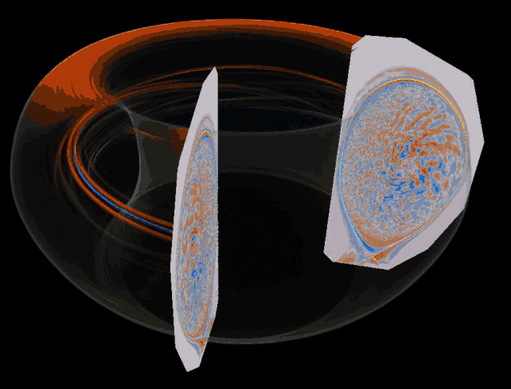
XGC for Studying Critical Edge Physics
XGC is a set of codes to modelgyrokinetic microturbulence in the simulation of fusion reactors
DOE SciDAC for Edge Physics Simulation (EPSi)
Particle-in-cell (PIC) codes:
XGC0, XGC1, XGC1a, XGC2, …
XGC1
ODE-based PIC approach on space grid using unstructured triangular grid
5D gyrokinetic equations
ODE: time advance of marker particles
finite difference: partial integro-differential Fokker-Planck collision operator discretized on rectangular v-space grid
PDE (PETSc): Maxwell’s equations on unstructured triangular x-space grid
Usual interpolation issue exists

Slide 39
XGC1 Development and Performance
Development of electromagnetic turbulence capability
Requires more accurate calculation of electrical current
More particles requires greater scaling
Challenge to run on heterogeneous systems (Titan)
Electron subcycling time-advance takes ~85% of total time
designed to be without external communication in each cycle
ideal for occupying GPUs while other routines use CPUs
solver spend <5% of total computing time
Weak scaling in number of particles
XGC1 has not reach the MPI communication limit
#particles per grid-node is fixed
#grid-nodes memory determined by compute-node memory
need more compute nodes

Slide 40
XGC1 Performance Study (Titan, ACISS)
EPSi with DOE SUPER institute is optimizing XGC1
Computational kernel including port to GPU
OpenMP parallelism
MPI communication
Use TAU to investigate XGC1 performance questions:
How to efficiently split work between the CPU and GPU?
How to improve the cache performance in the GPU?
Effects of memory copying with multiple GPUs per node
Experiments done on ACISS and Titan
ACISS: 12-core 2.67GHz Xeon X5650 / Tesla M2070 (3x)
Titan: 16-core 2.2GHz Opteron 6274 / Tesla K20X

Slide 41
XGC Work Sharing Between CPU/GPU (ACISS)
Look at CPU+GPU worksharing execution scenario
Electron 'push' takes 85% of the computation time
Kernel (pushe2) was ported to the GPU
Assigning more work to the GPU can shorten the execution since it can compute the kernel faster
Notes:
The work that is being shared between the CPU and GPU is the ion/electron pushing.

Slide 42
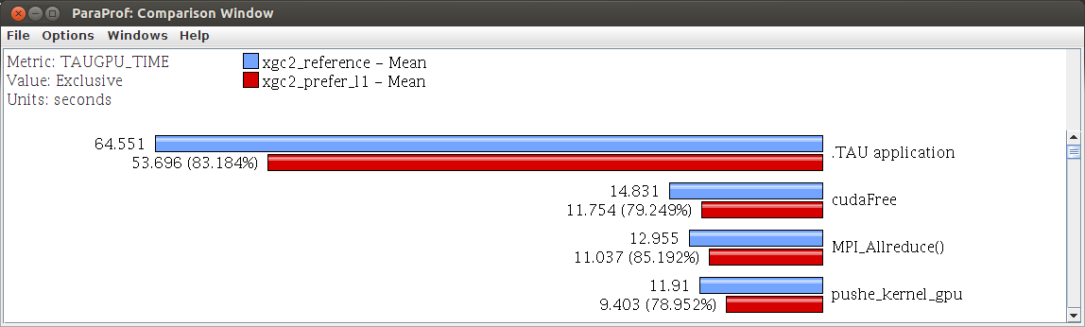
XGC Cache Optimization (ACISS)
Shared memory capacity
L1 cache and device shared memory share physical storage
Default: 48KB shared memory / 16KB L1 cache
CUDA allows you to swap this allocation
Improved the performance of the pushe2 kernel (~20%)
Improved the performance of XGC application (~17%)

Slide 43
Memory Copies with Multiple GPUs in XGC
Given multiple GPUs per node in ACISS
XGC could be run with multiple MPI ranks per node
Each rank would be assigned 1 GPU
Performace effect of CPU-GPU memory copies
Compare
1 MPI rank per node with 1 GPU
3 MPI ranks per node with 3 GPUs
Slow memory copies result with multiple ranks+GPUs
Slow memory copies can lead to MPI waiting
Leads to a slow down in MPI collectives

Slide 44
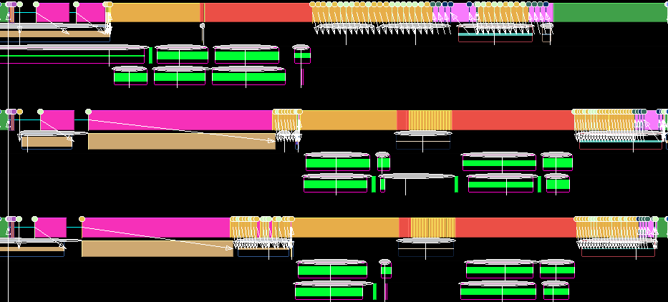
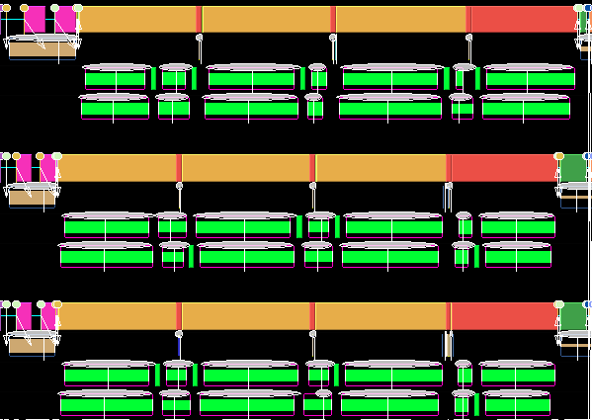
XGC Performance with Different # GPUs (ACISS)
3 MPI ranks
3 GPUs per node (6 seconds)
Slow memory copies …
… cause faster MPI ranks to stall at MPI_Reduce
3 MPI ranks (different nodes)
1 GPU per node (4 seconds)
Fast memory copies better aligns processes and reduces MPI stalls

Slide 45
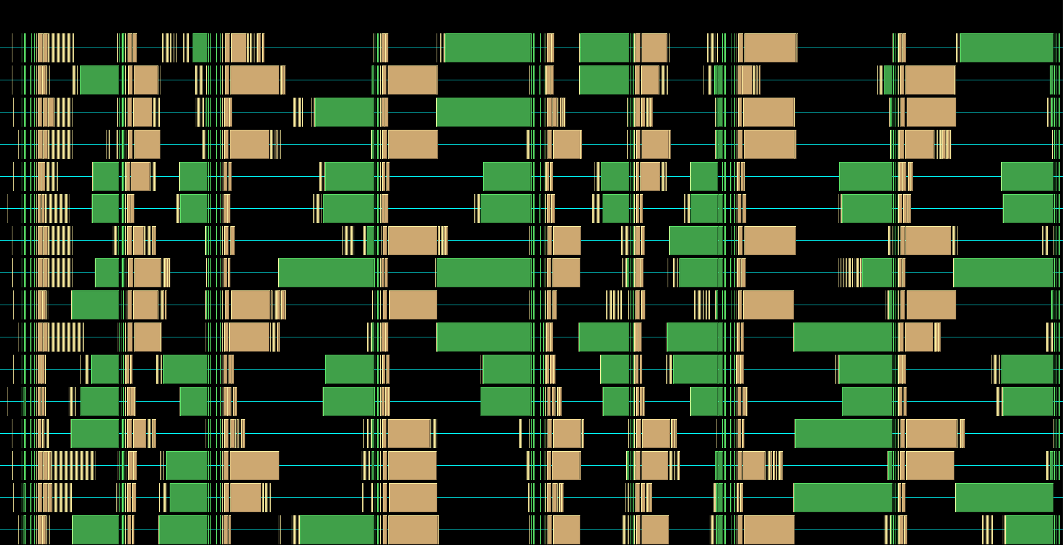
XGC MPI Imbalance Due to PCI Bus Sharing
16 ACISS nodes
3 GPUs per node (6 seconds)
Slow memory copies …
… cause faster MPI ranks to stall at MPI_Reduce

Slide 46
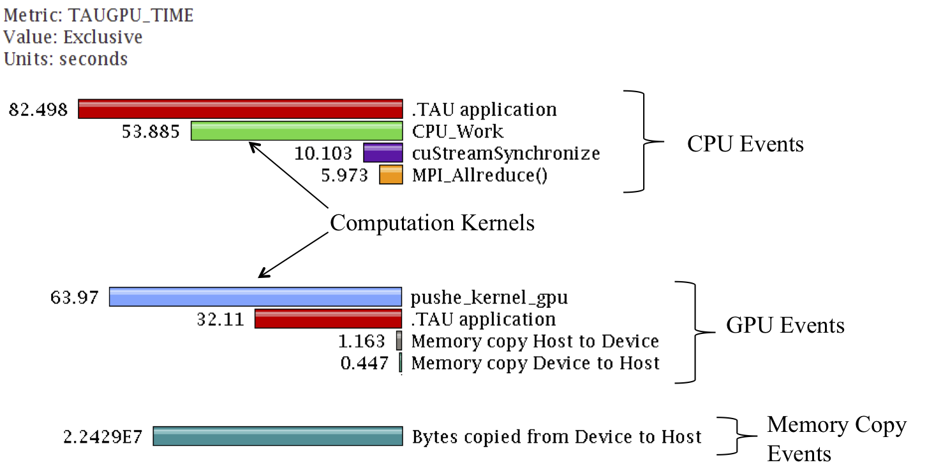
Heterogeneous Performance Measurement (Titan)
CPU+GPU worksharing execution scenario

Slide 47
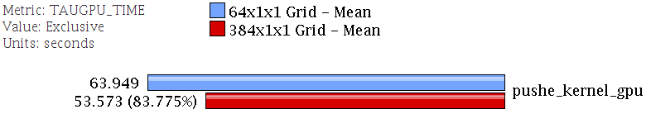
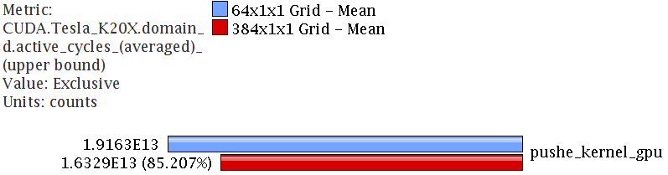
XGC Increasing Grid Size (Titan)
Allocating a larger grid to improve GPU efficiency
Larger grid size increases the number of active cycles by 15% and gives a 5% increase in total SM efficiency

Slide 48
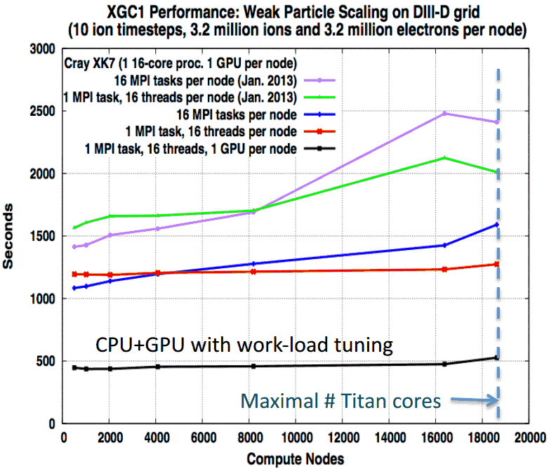


XGC1 Performance Scaling (Titan)
EPSi-SUPER collaboration
Weak scaling on DIII-D grid
10 ion timesteps
3.2 million ions
3.2 million electrons per node
Ran 512 node experiment
512 Nodes

Slide 49


IRMHD Performance (Intrepid and Mira)
INCITE magnetohydrodynamcis simulation to understand solar winds and coronal heating
First direct numerical simulations of Alfvén wave (AW) turbulence in extended solar atmosphere accounting for inhomogeneities
IRMHD
Inhomogeneous Reduced Magnetohydrodynamics
Fortran 90 and MPI
Excellent scaling properties
Tested on Argonne BG/P (Intrepid)
Benchmarked on Argonne BG/Q (Mira)
HPC Source article and ALCF news
https://www.alcf.anl.gov/articles/furthering-understanding-coronal-heating-and-solar-wind-origin
Notes:
Figure 1. A snapshot of turbulent magnetic field lines (red) inside a coronal hole that expands from a small patch on the solar surface to 5 solar radii. AW, launched by convective motions on the photosphere, propagate in the inhomogeneous Solar atmosphere, producing primary reflected waves that interact non-linearly with the outward waves, driving a turbulent cascade. This cascade continues with secondary reflections in a very complex interplay between wave reflections and nonlinear interactions. Selected slices across the simulation domain show contours of plasma current, indicating the generation of small-scale structures where the turbulent energy ultimately dissipates.

Slide 50

Communication Analysis (MPI_Send, MPI_Bcast)
IRMHD demonstrated performance consistent with common synchronous communication bottlenecks
Significant time spent in MPI routines
Identify problems on 2,048-core execution on Intrepid
MPI_Send and MPI_Bcast took significant time
Suggest possible opportunities for overlapping computation and communication
Identified possible targets for computation improvements
MPI_Barrier
MPI_Send

Slide 51

Effects of IRMHD Optimizations (Intrepid)
Developed a non-blocking communication substrate
Deployed a more efficient FFT implementation
Overall execution time reduced from 528.18 to 79.85 core hours
2,048 processors
>7x improvement

Slide 52


Performance Testing on Mira (BG/Q)
Test with 32K MPI ranks
Load imbalance apparent
See imbalance reflected in MPI_Alltoall() performance

Slide 53

Optimizations on Mira
Remove MPI_Barrier in regions where not needed
Next, oversubscribe nodes …

Slide 54

Oversubscribing Mira Nodes
Vary #MPI ranks on nodes (1024 nodes)
16 ranks per node (16K) versus 32 ranks per node (32K)
Overall time improvement
71.23% of original
More efficient barriers within node leads to performance improvement

Slide 55

Performance Variability in CESM
Community Earth System Model (CESM)
Observed performance variability on ORNL Jaguar
Significant increase in execution time led to failed runs
End-to-end analysis methodology
Collect information from all production jobs
problem/code provenance
system topology
system workload
process node/core mapping
job progress
time spent in queue
pre/post, total
Load in TAUdb, qualtify nature of variability and impact

Slide 56



Example Experiment Case Analysis
4096 processor cores
6 hour request
150 simulation days
35 jobs
May 15 – Jun 29, 2012
Two of which failed
Minimum execution time
Maximum execution time
High variability intra-run

Slide 57




TAUdb and CCSM Data – Mismatched Nodes
5:35:50 (hh:mm:ss)
Slowest – 272 unmatched
4:14:08 (hh:mm:ss)
Fastest – 0 unmatched

Slide 58




Extents of Gemini Network Matter
Notes:
Yes, it is a fully connected torus – but there is still a correlation…

Slide 59




MPI Rank Placement Matters Too
Fastest case:
4:14:08
(hh:mm:ss)
Slowest case:
5:35:50
(hh:mm:ss)
Cube View
Cube View
Z-connected torus view
Z-connected torus view

